Slide 1
Modeling Sequence Data

Slide 2
1. Neurons with Recurrence (intuitions of RNNs) 2. Vanilla Recurrent Neural Networks (RNNs) 3. Sequence Modeling Problem: Predict the Next Word 4. Backpropagation Through Time (BPTT)
5. Long Short Term Memory (LSTM) Networks
6. RNN Applications

Slide 3
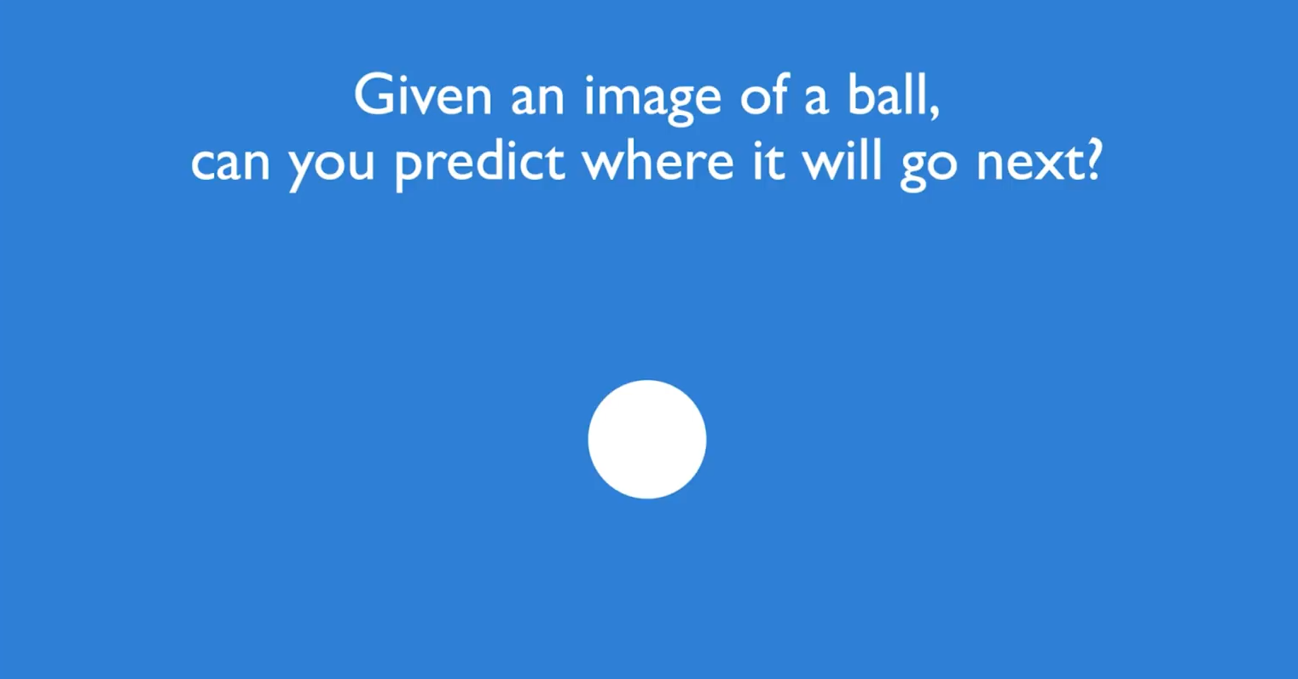

Slide 4
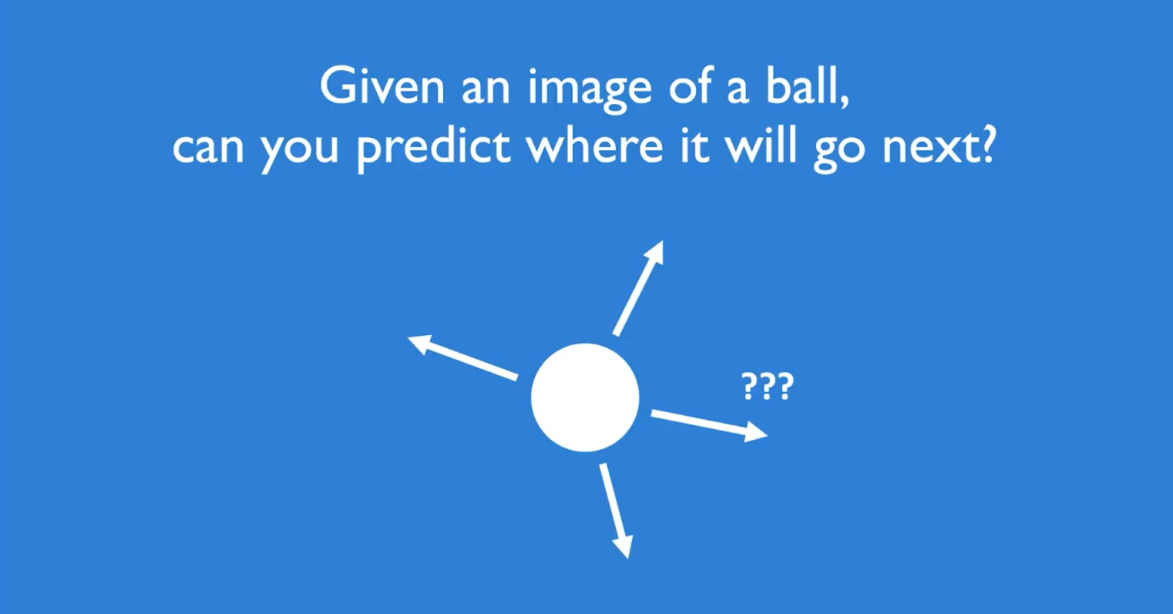

Slide 5
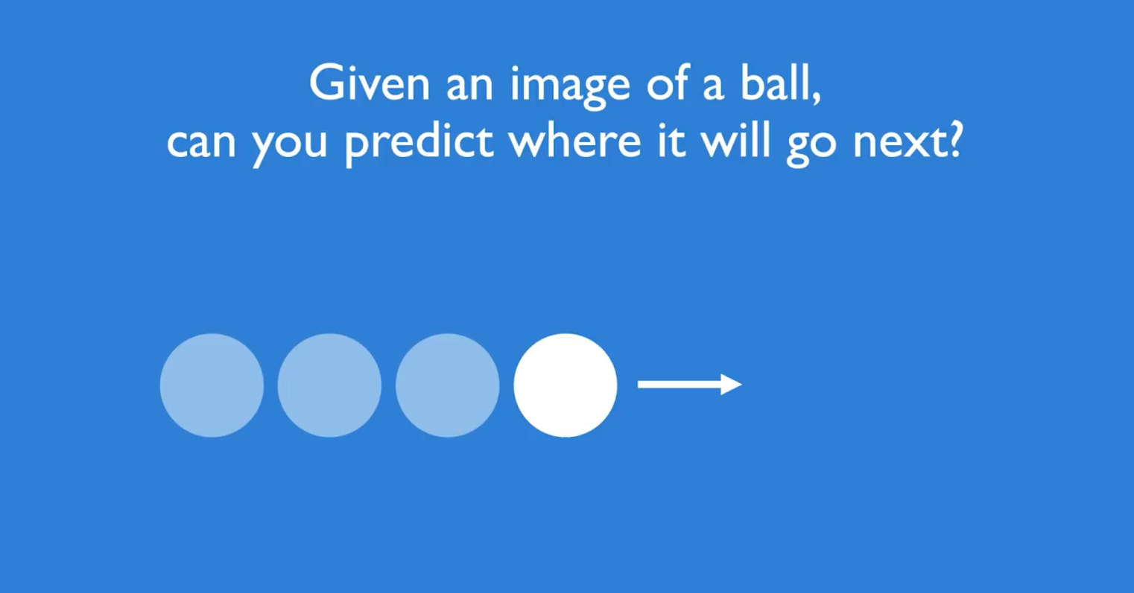

Slide 6
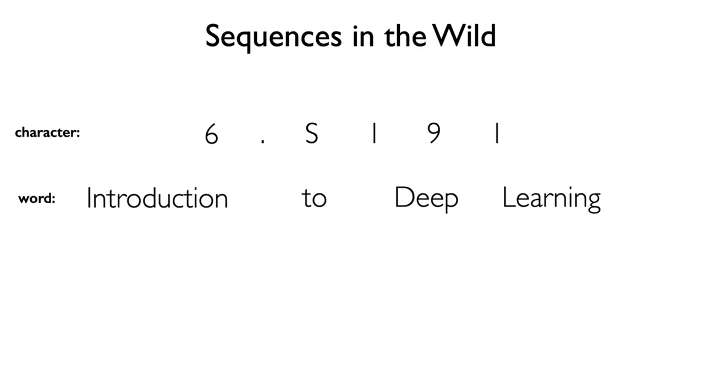
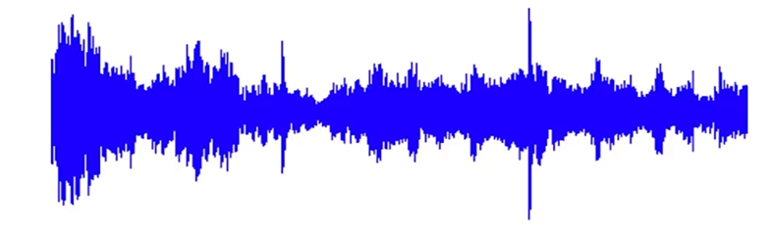
Audio:

Slide 7

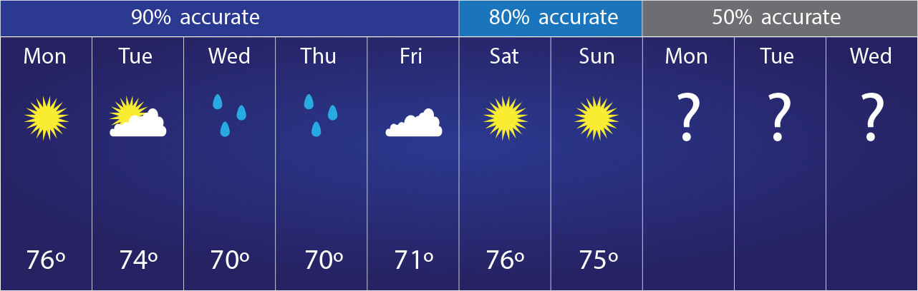
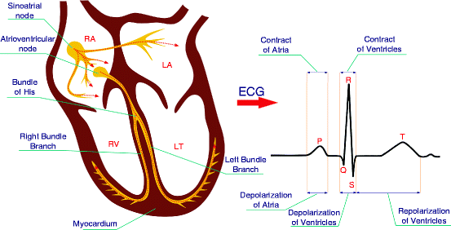
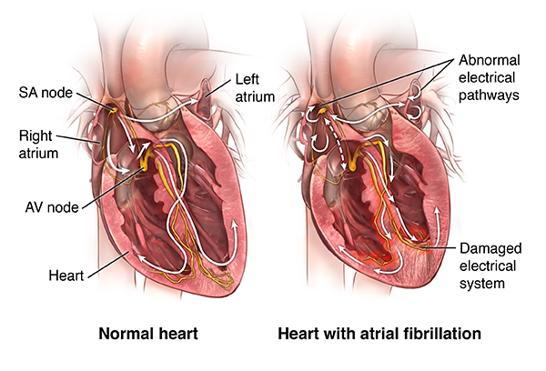
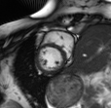
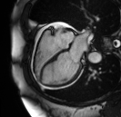
Audio:

Slide 8
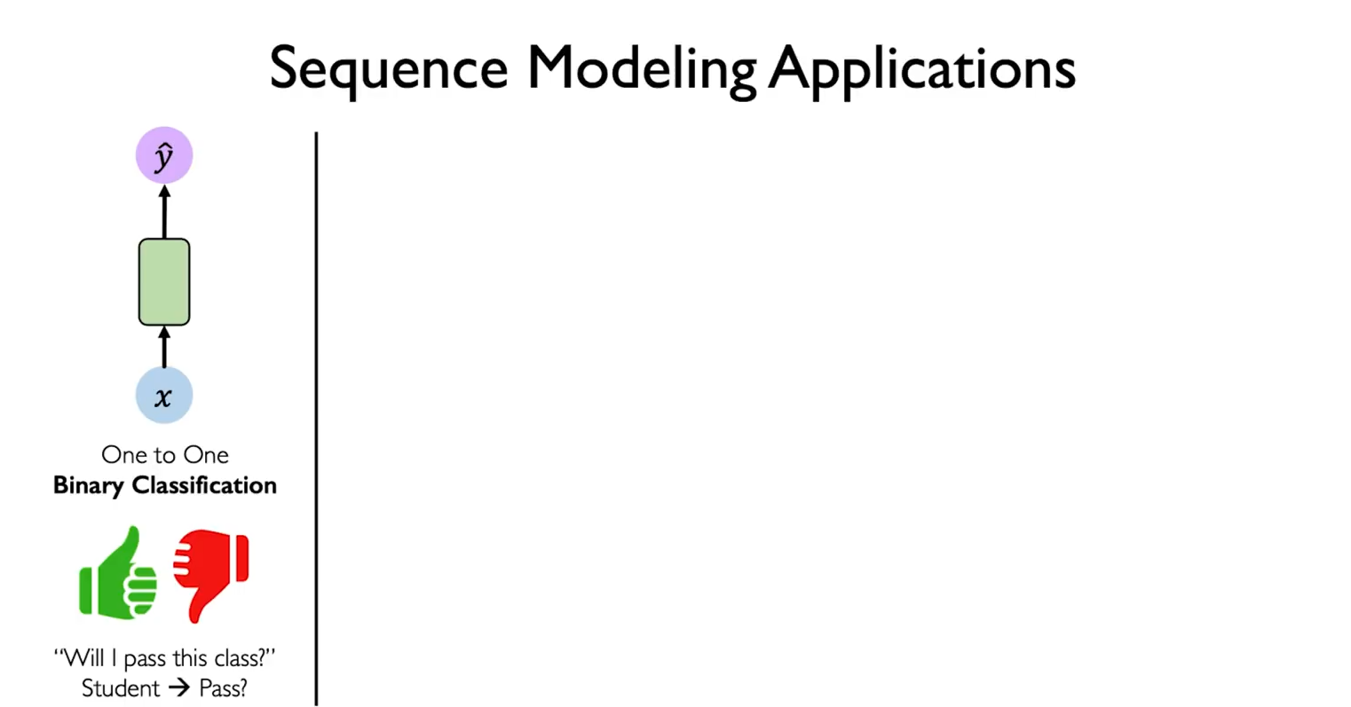

Slide 9
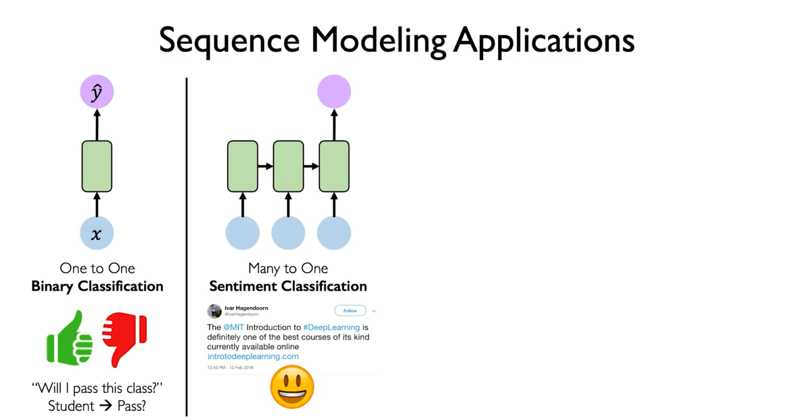

Slide 10
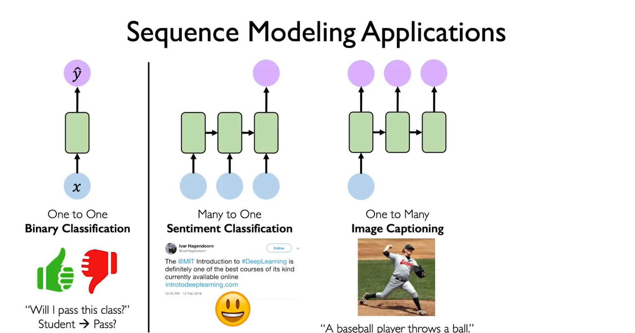

Slide 11
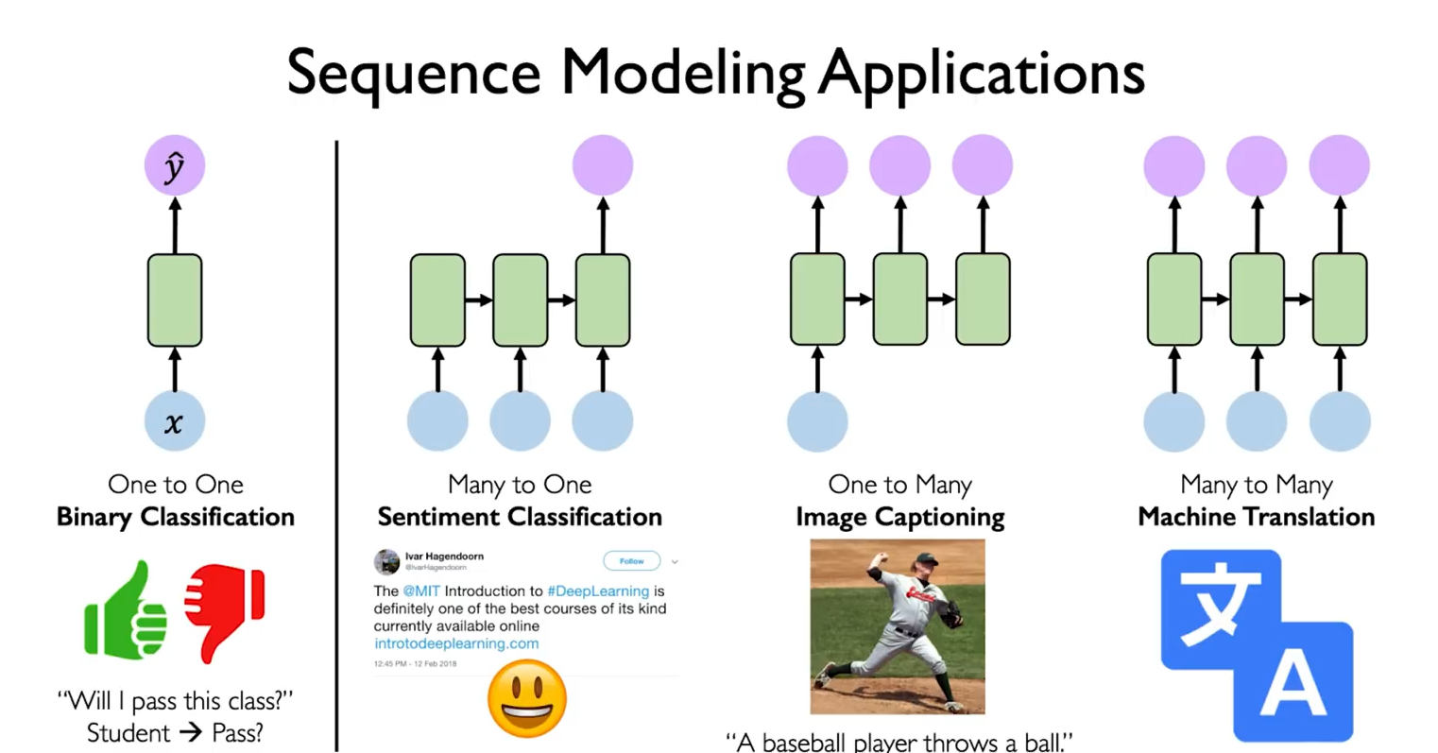

Slide 12
Neurons with Recurrence

Slide 13
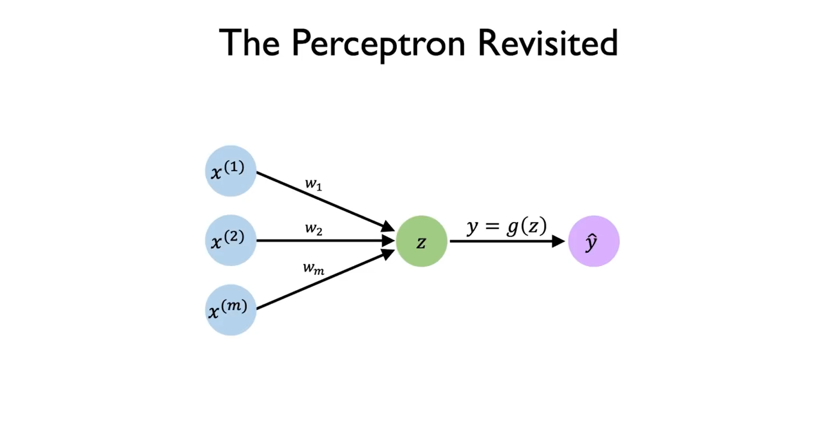

Slide 14
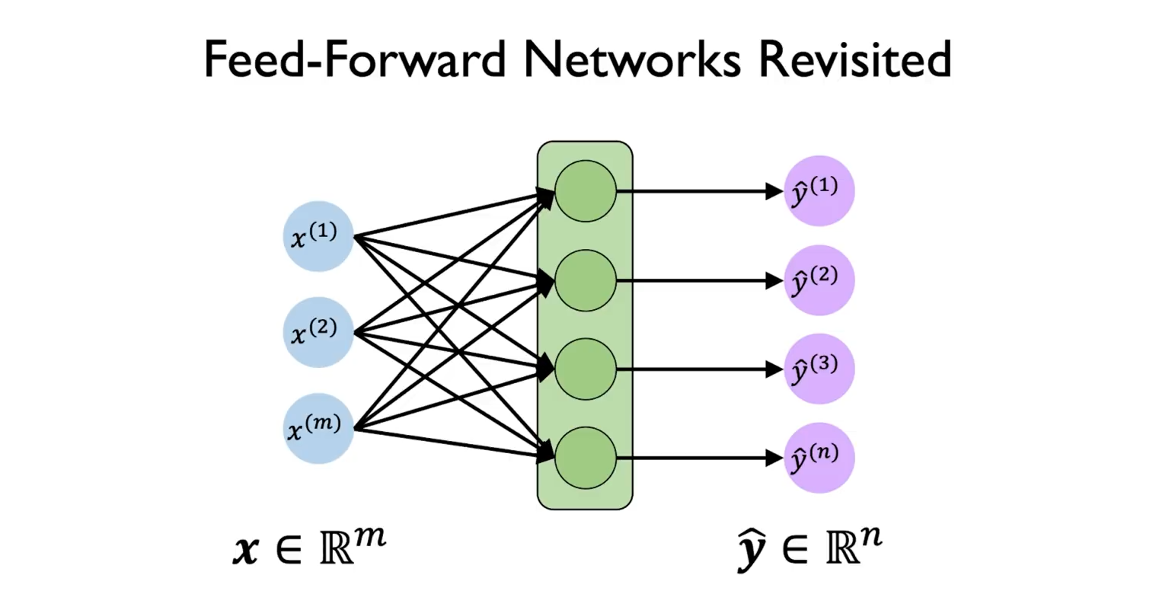

Slide 15
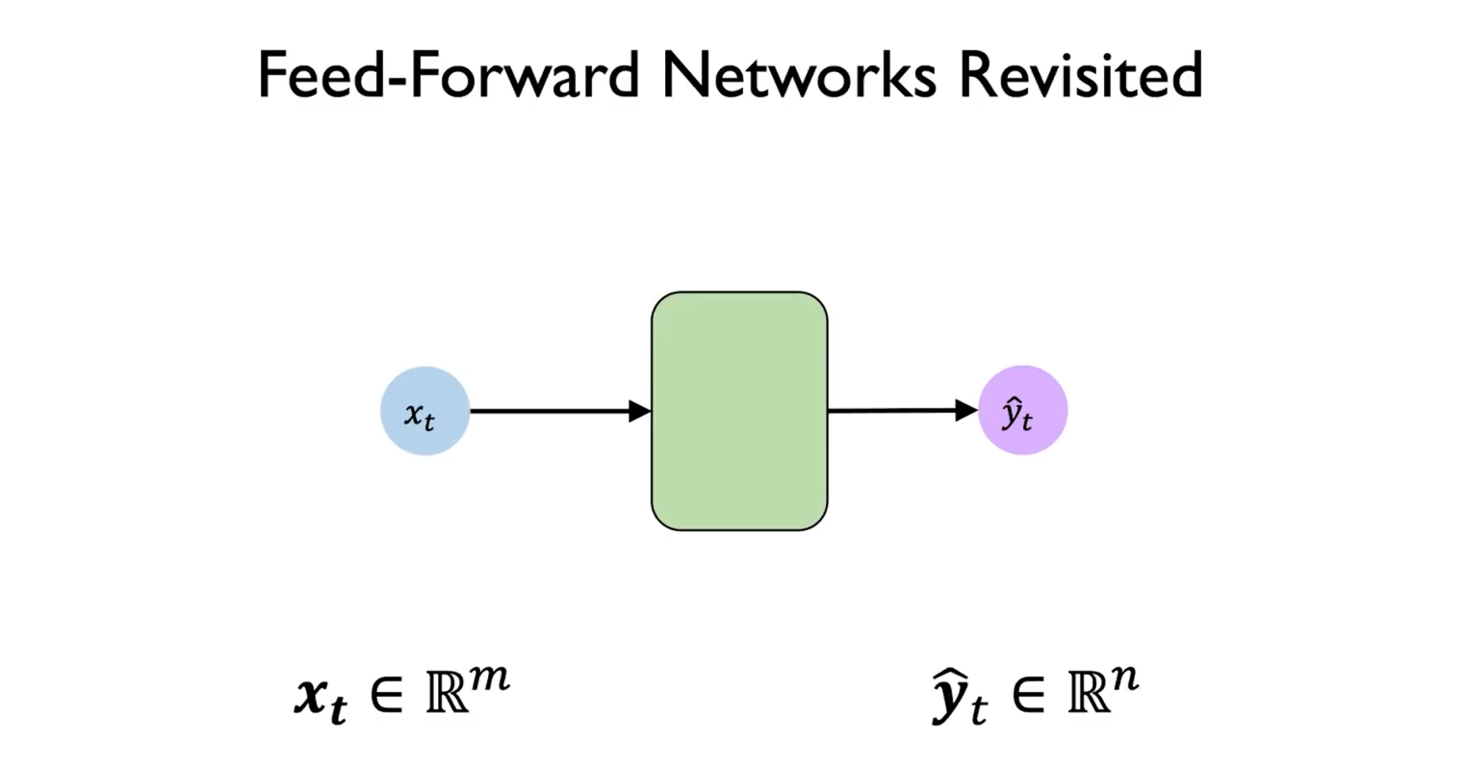

Slide 16
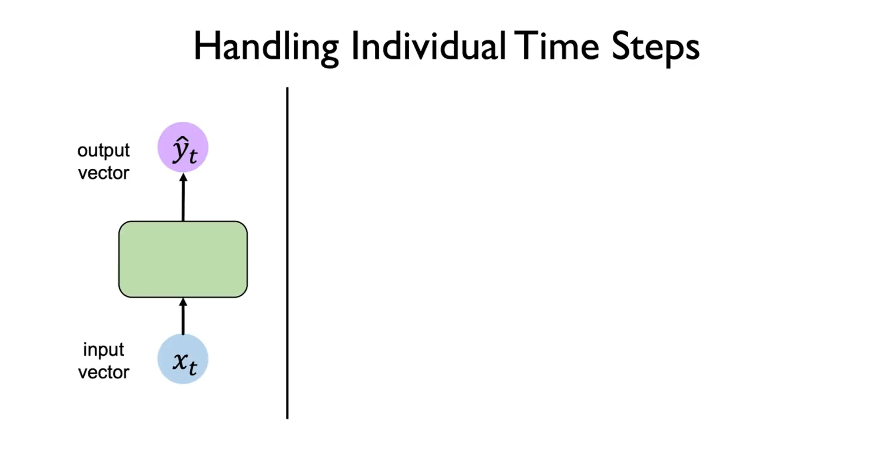

Slide 17
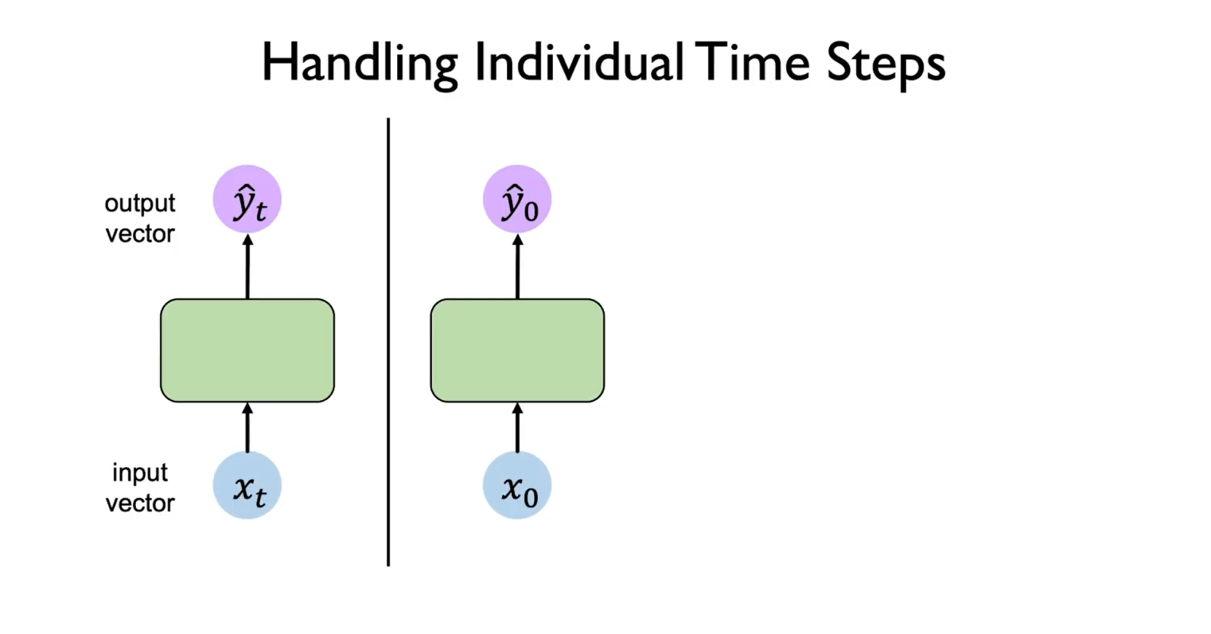

Slide 18
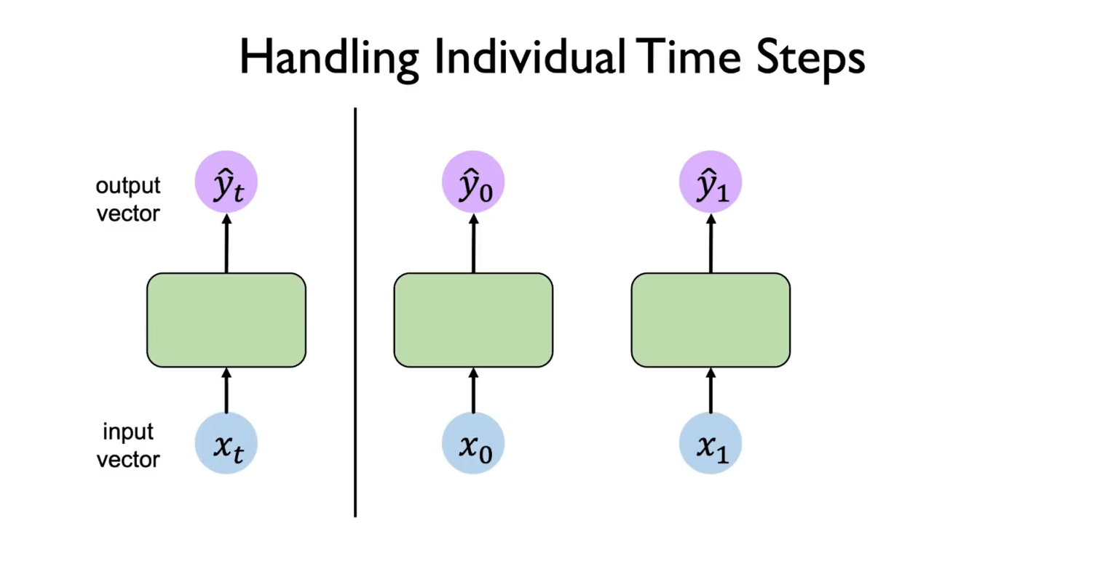

Slide 19
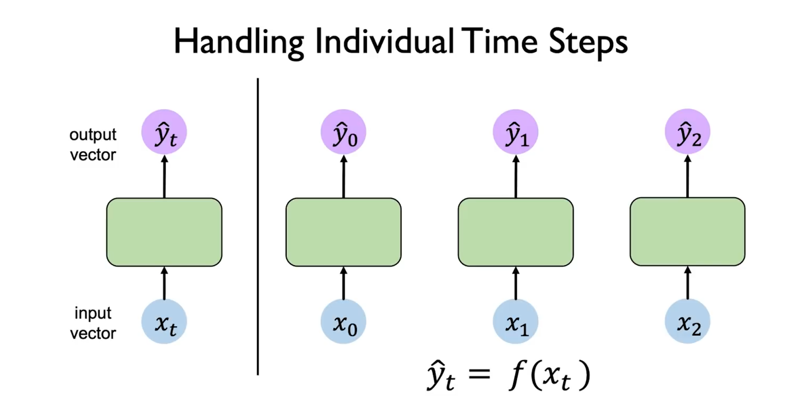

Slide 20
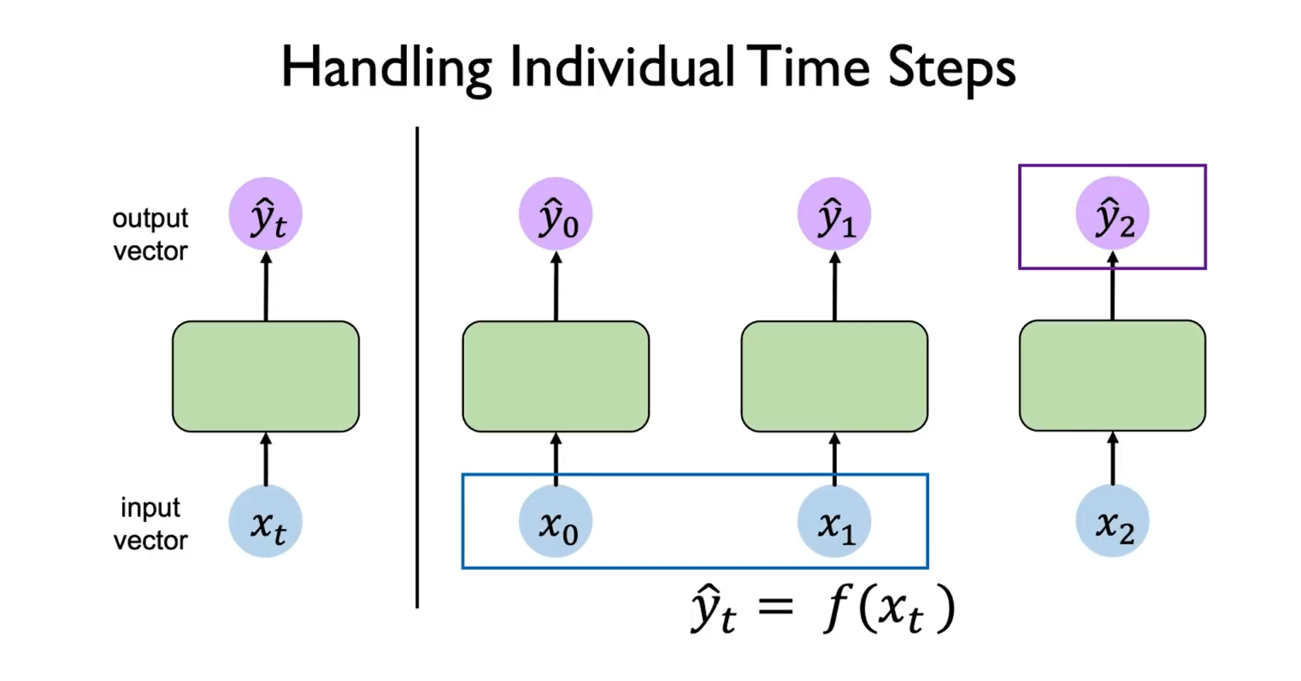

Slide 21
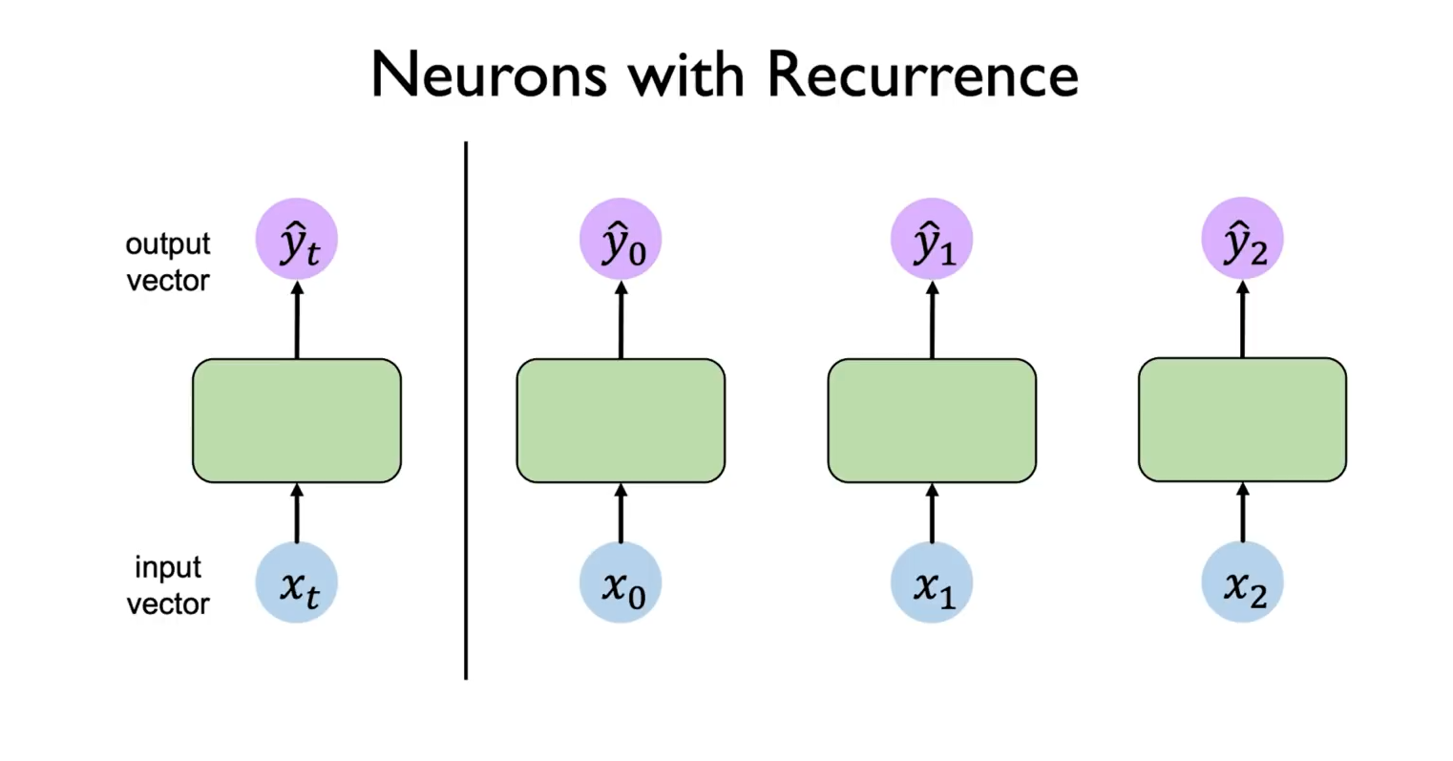

Slide 22
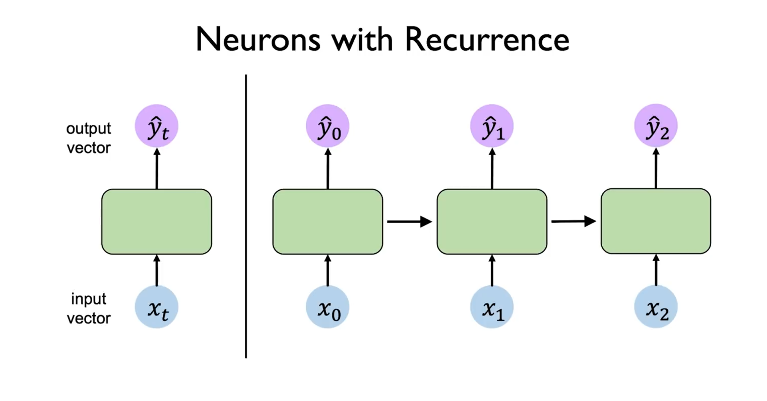

Slide 23
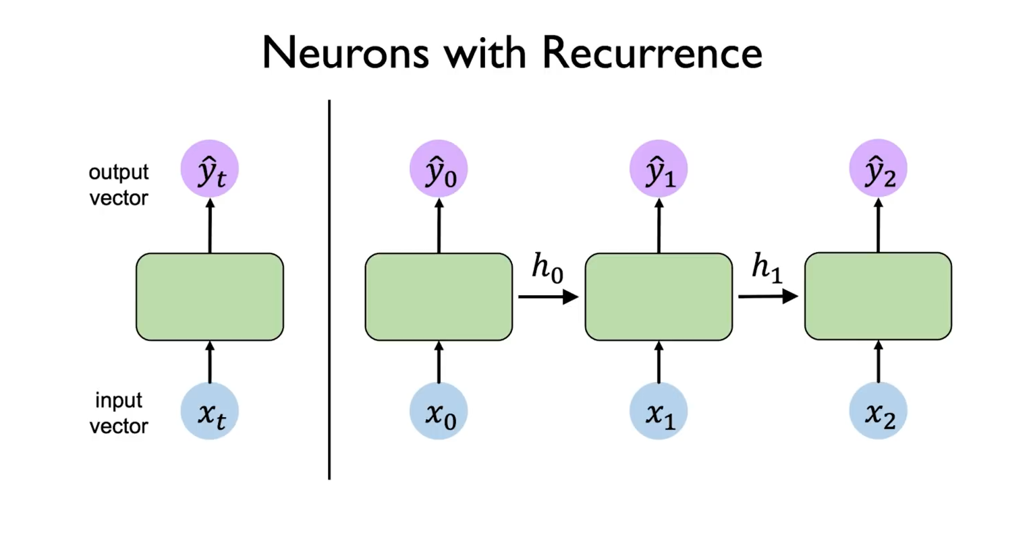

Slide 24
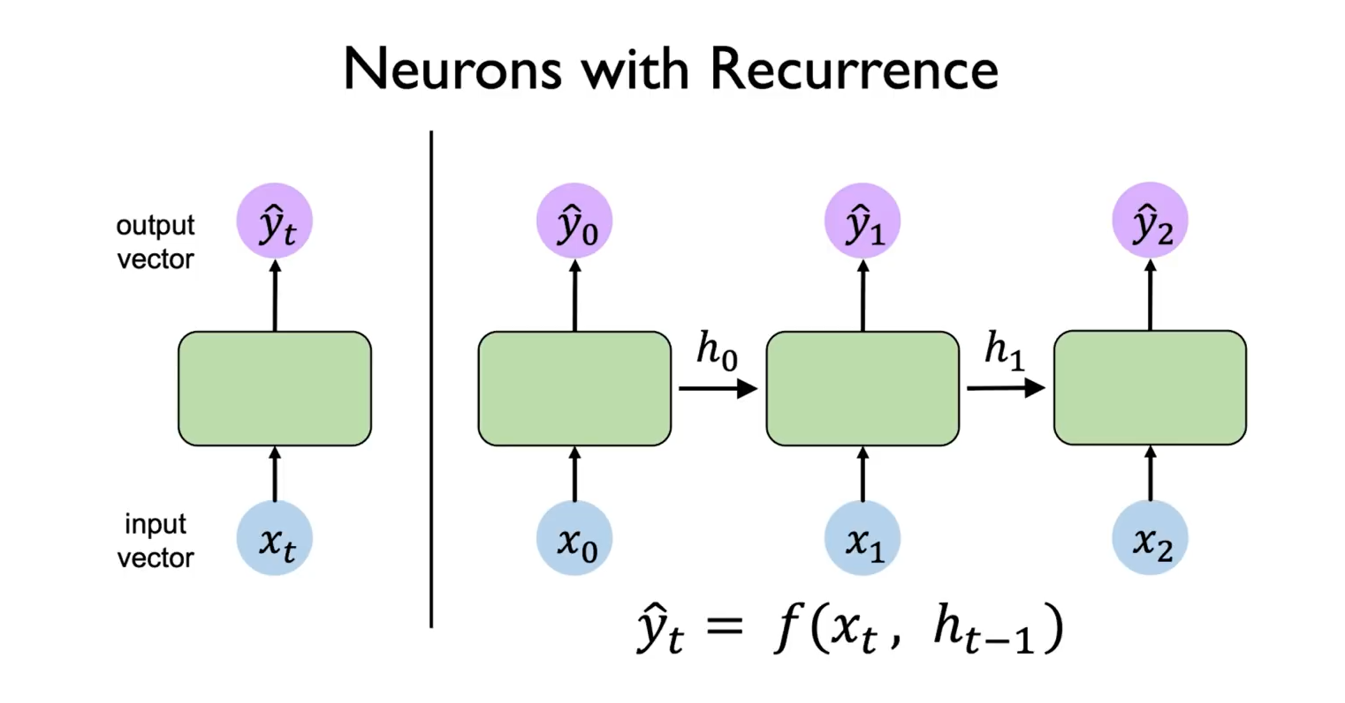

Slide 25
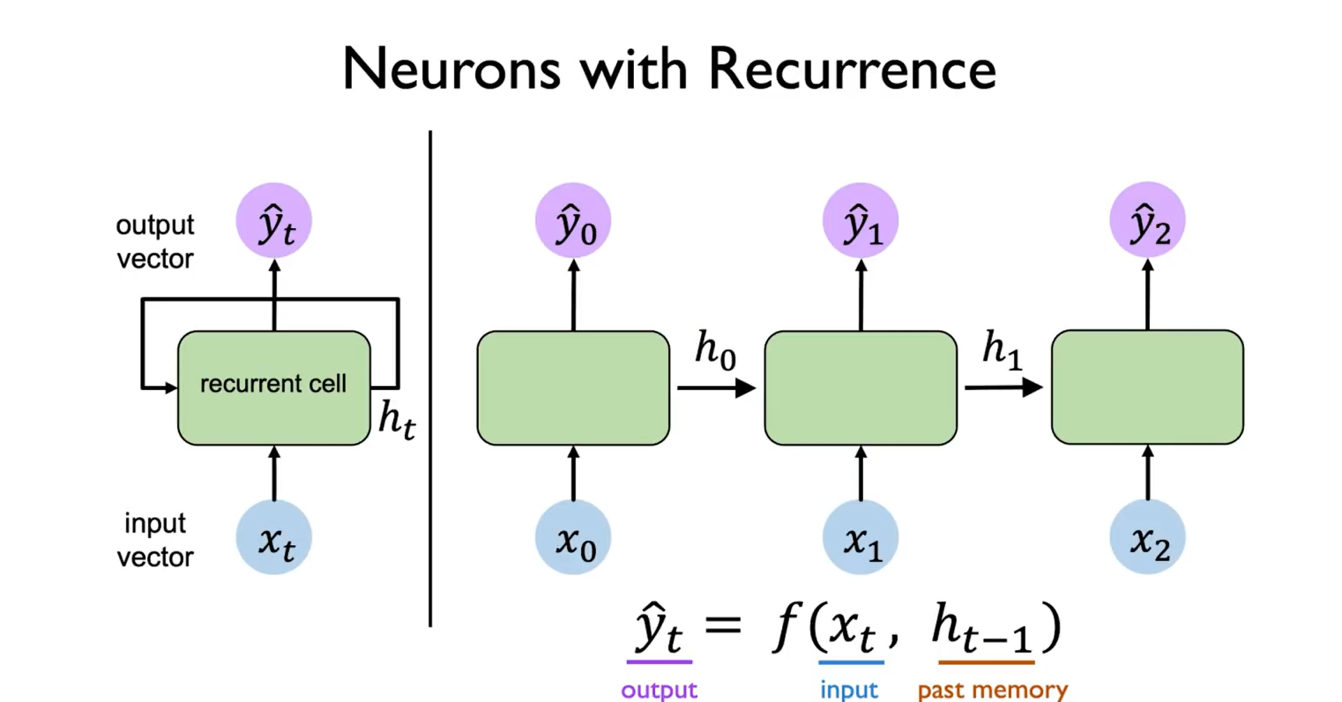

Slide 26
Vanilla Recurrent Neural Networks (RNNs)

Slide 27
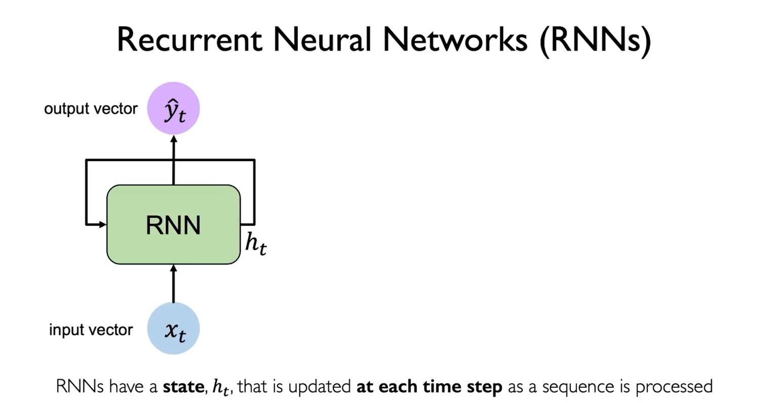

Slide 28
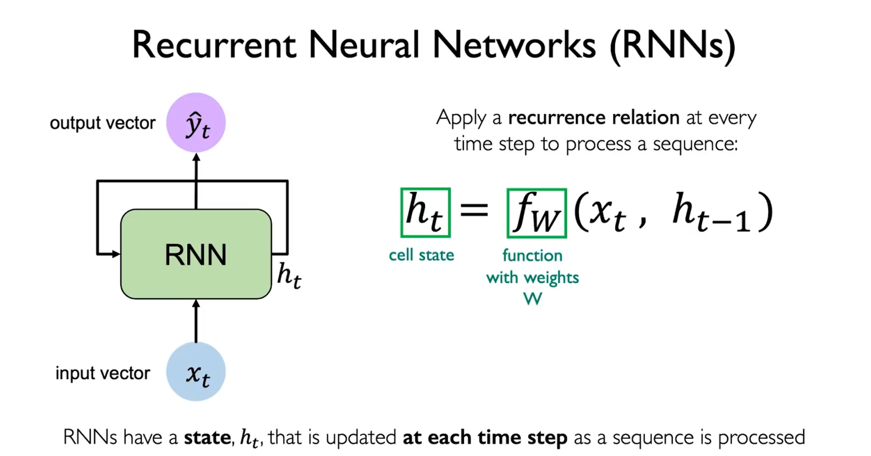
hidden state

Slide 29

hidden state

Slide 30
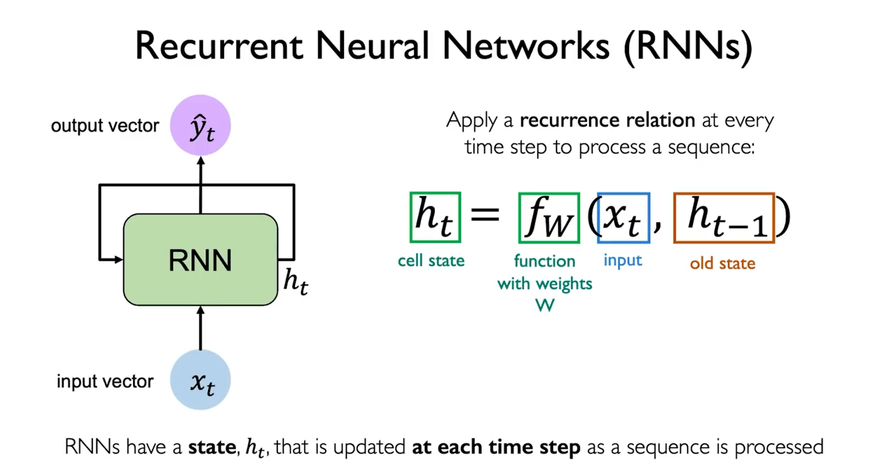
hidden state

Slide 31
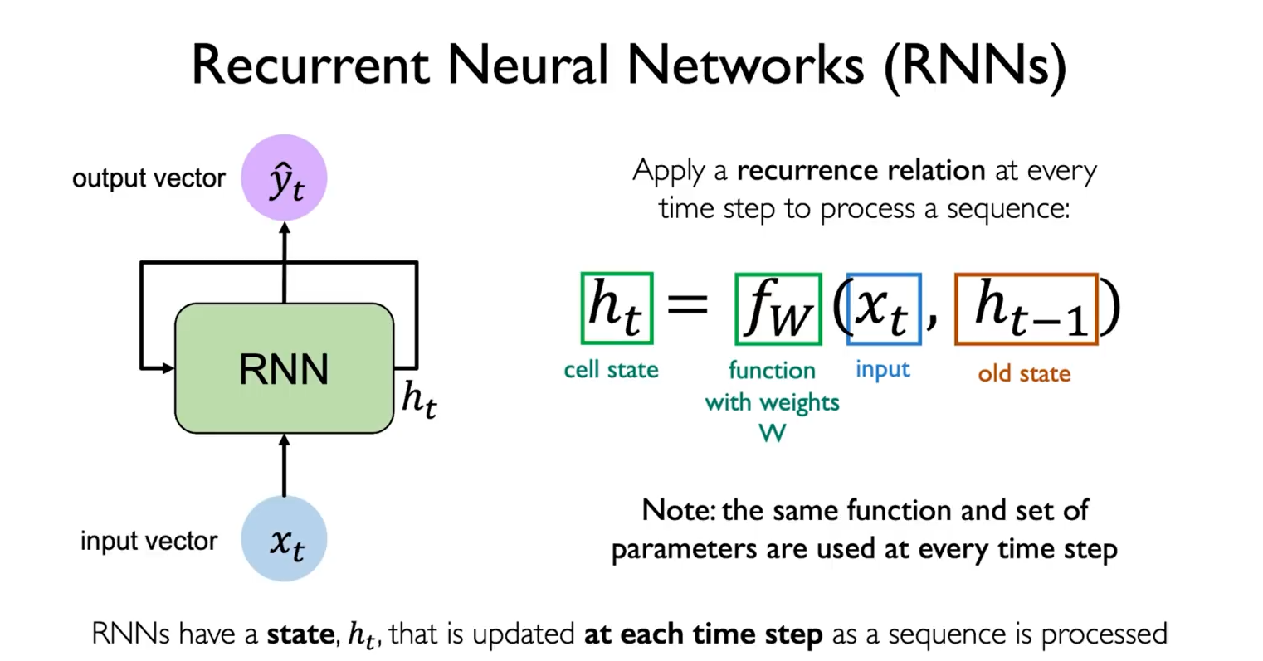
hidden state

Slide 32
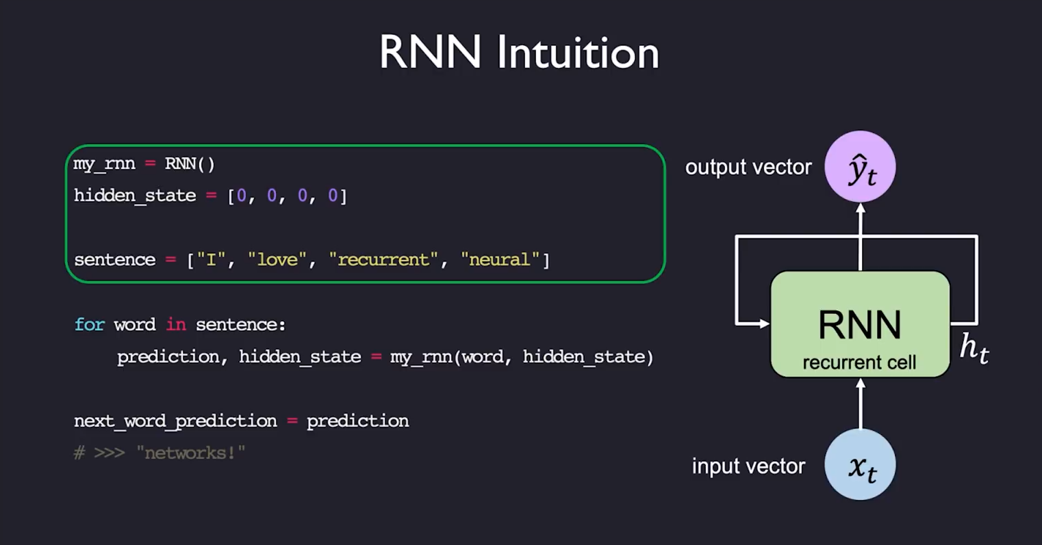

Slide 33
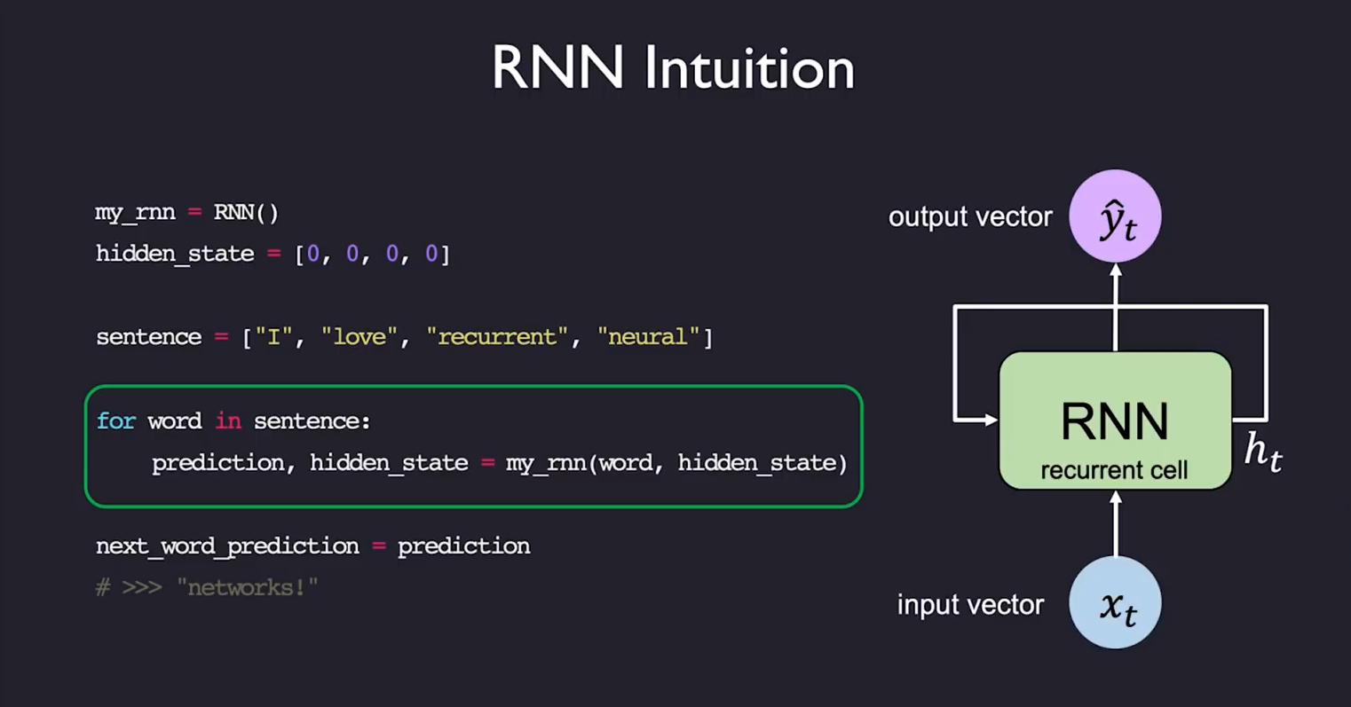

Slide 34
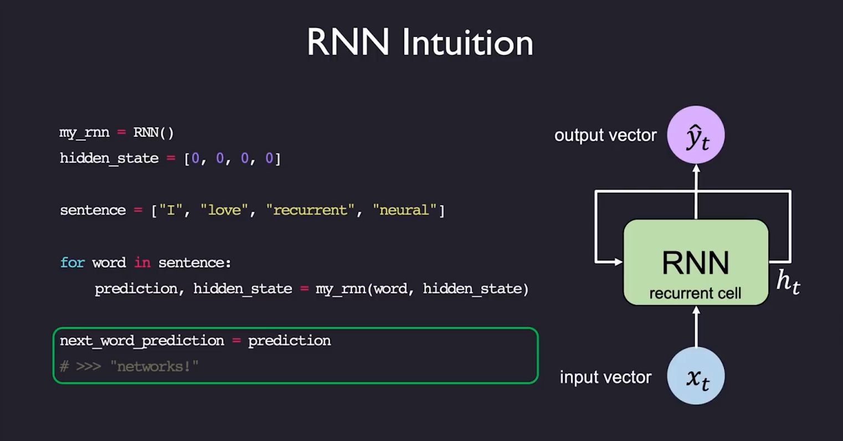

Slide 35
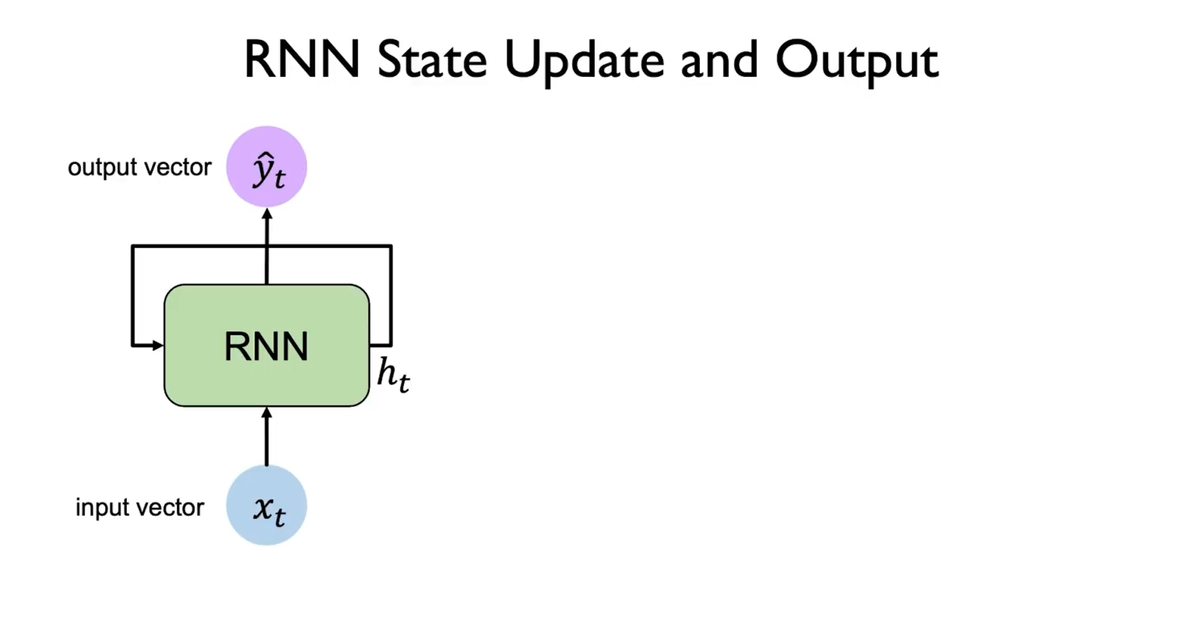

Slide 36
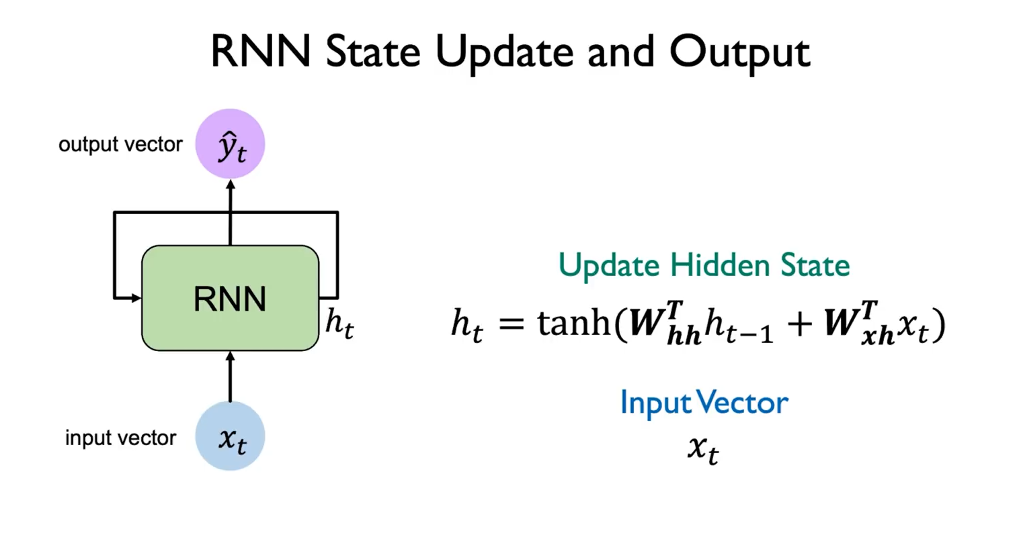

Slide 37
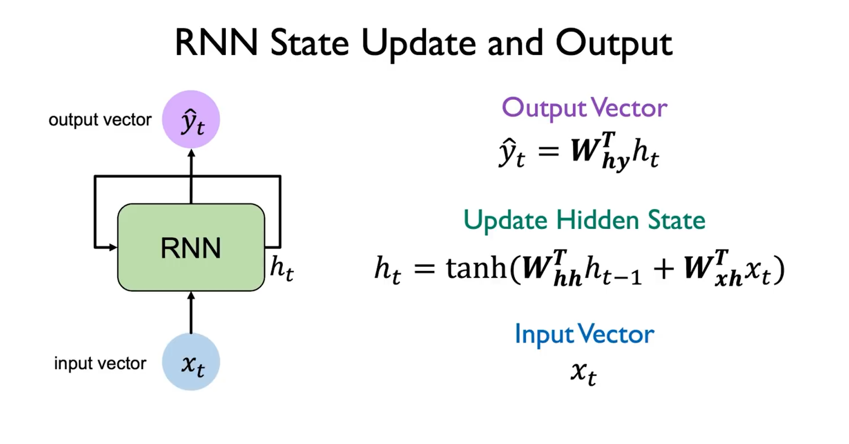

Slide 38
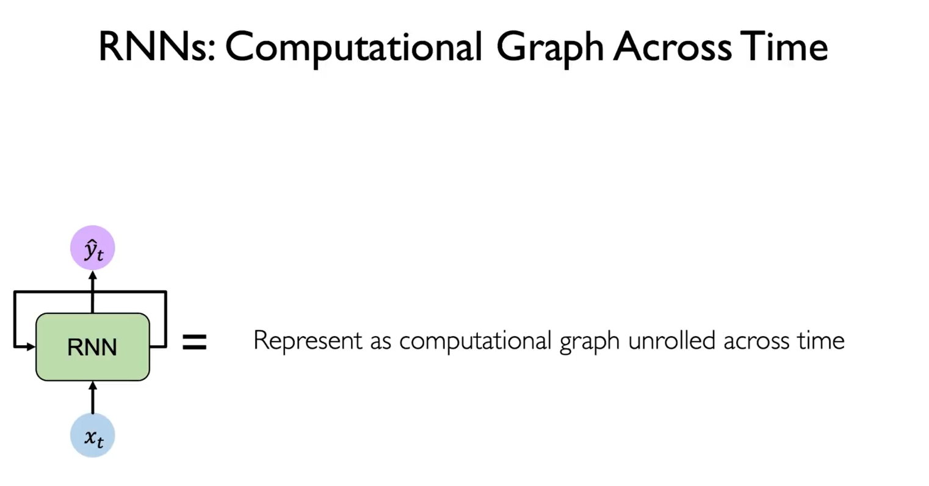

Slide 39
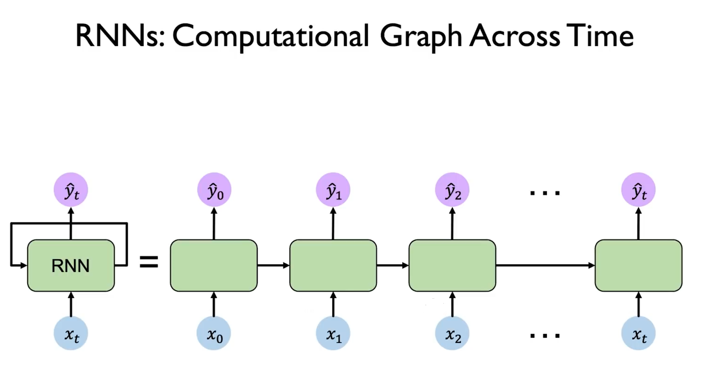

Slide 40
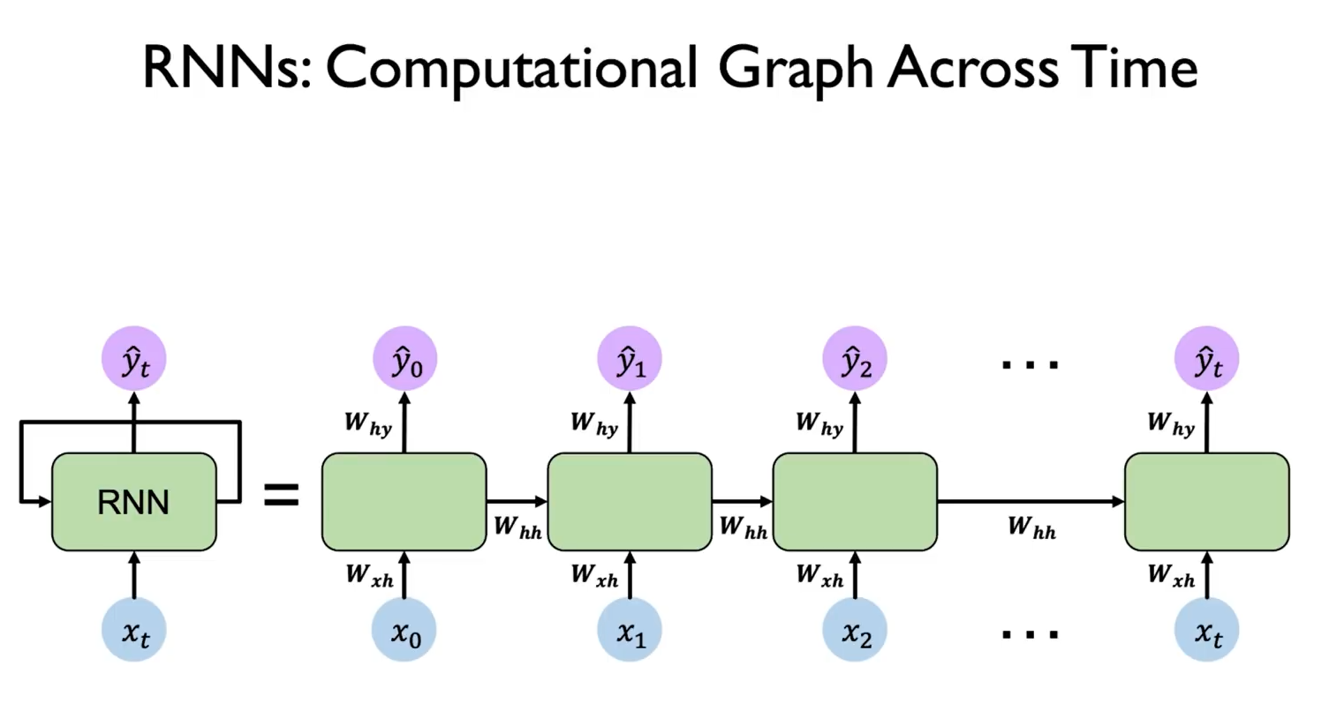

Slide 41
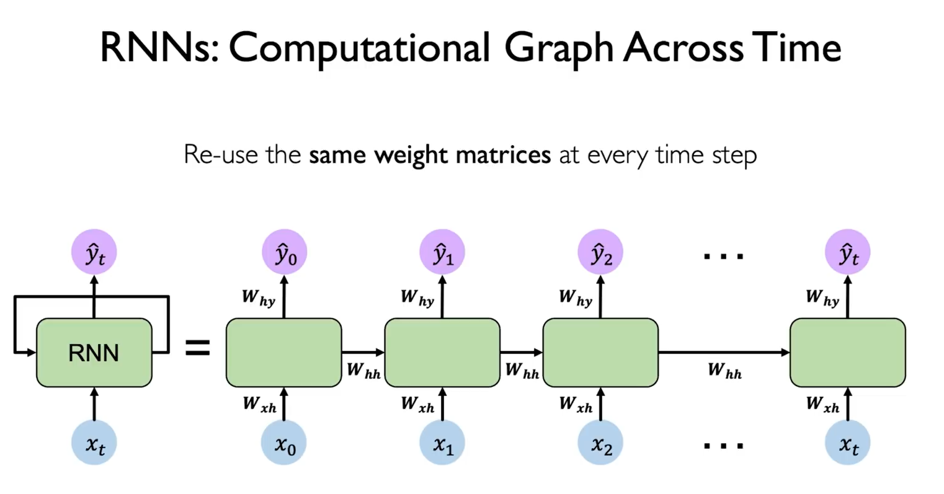

Slide 42
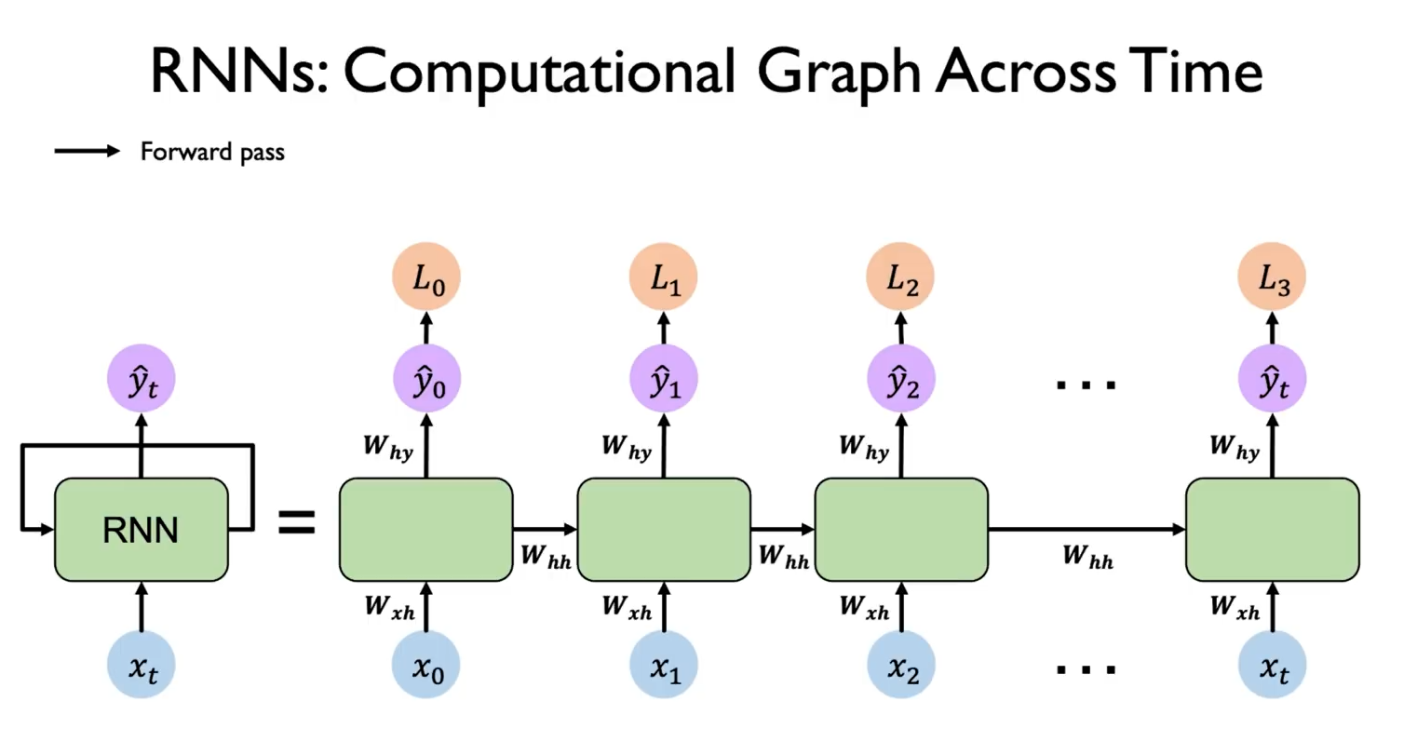

Slide 43
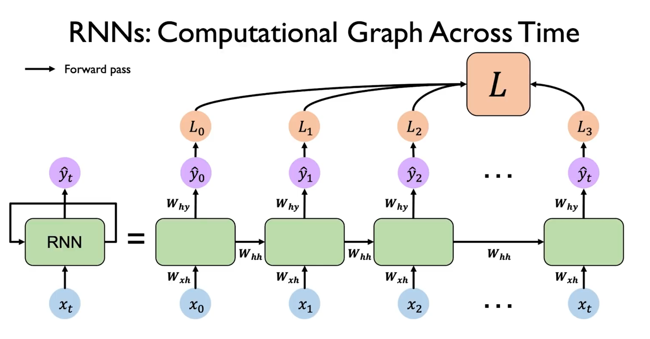

Slide 44
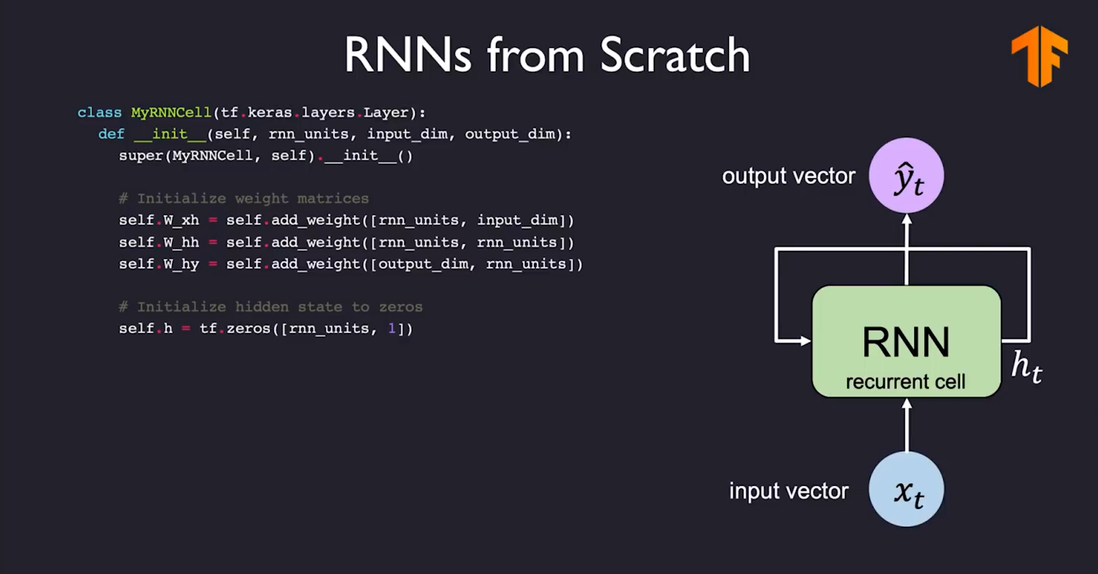


(torch.nn.Module):

Slide 45
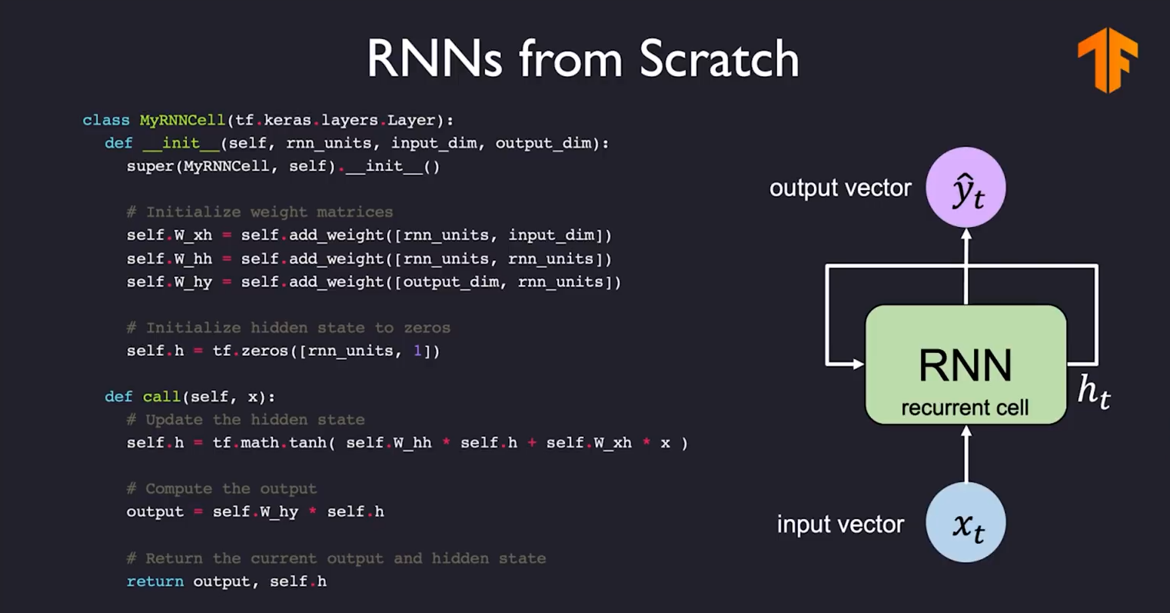
(torch.nn.Module):

Slide 46
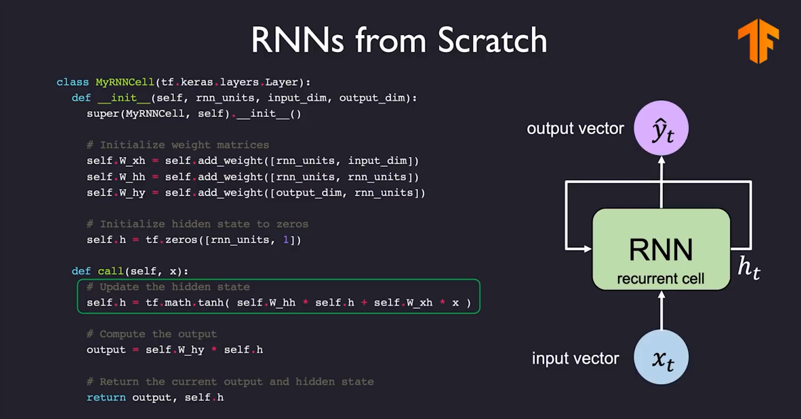
(torch.nn.Module):

Slide 47
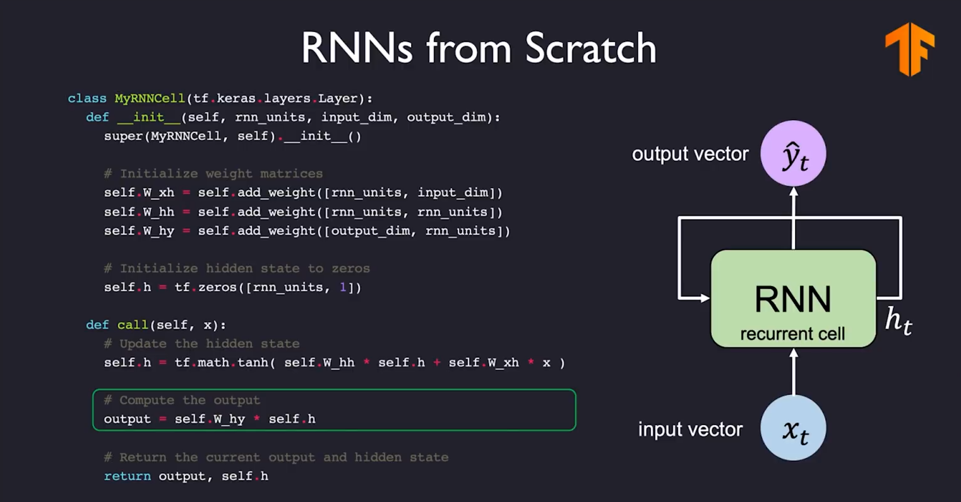
(torch.nn.Module):

Slide 48
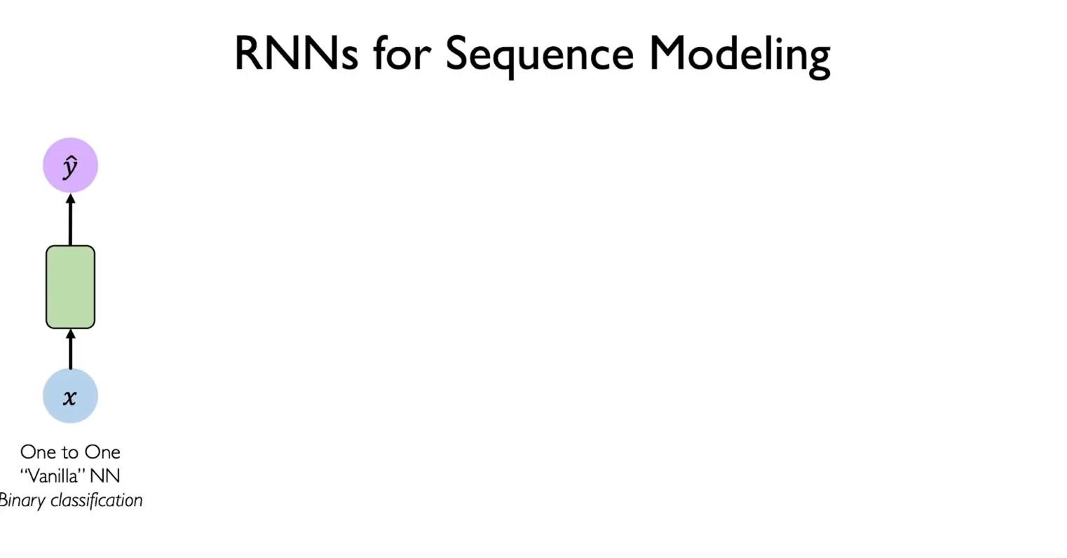

Slide 49
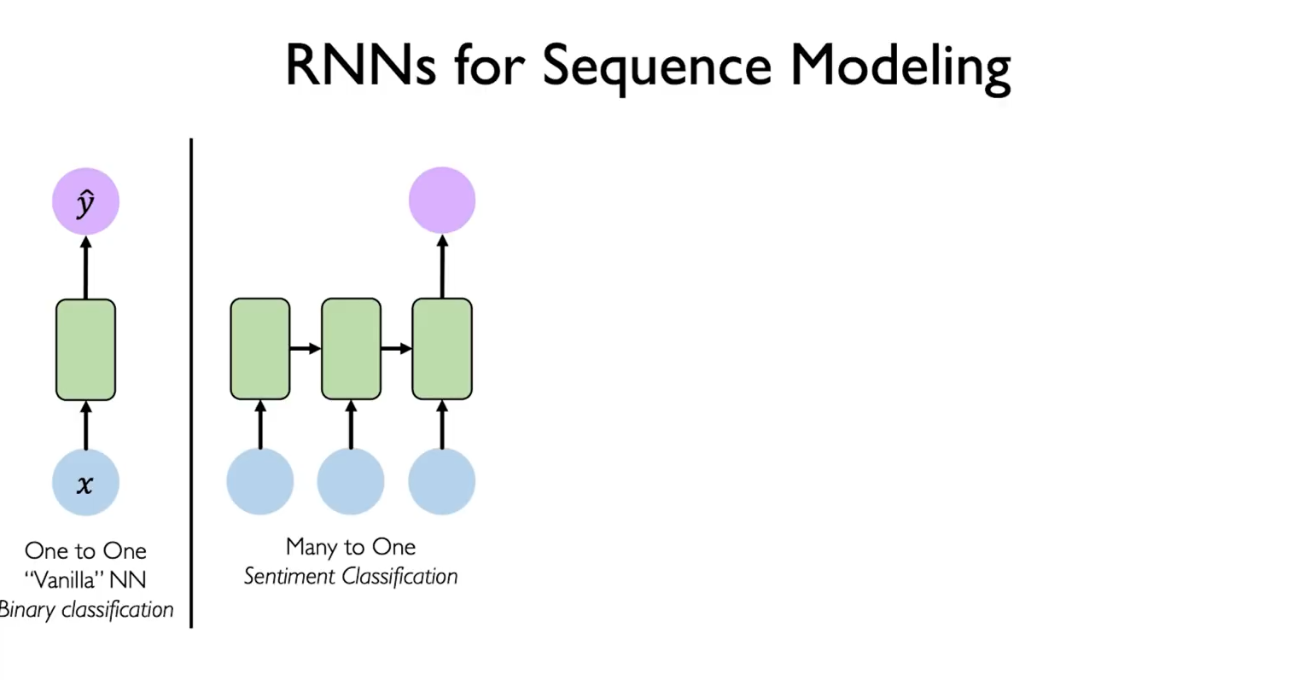

Slide 50
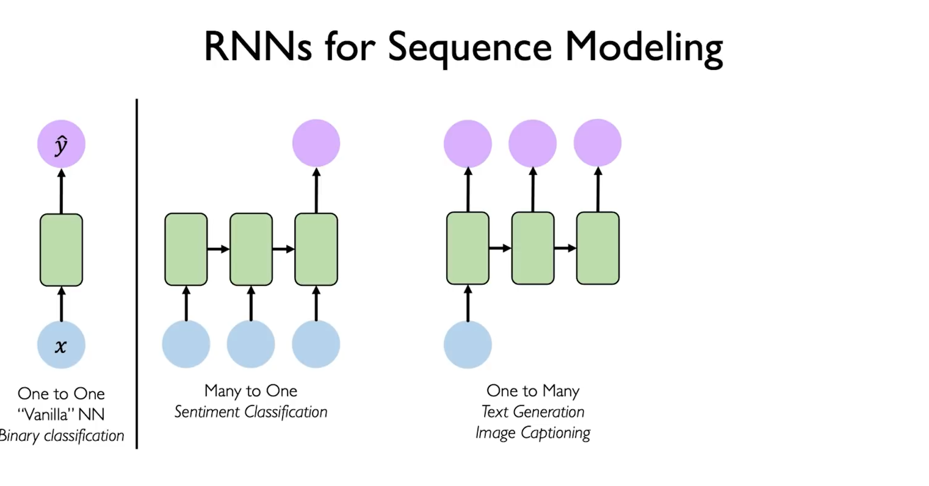

Slide 51


Slide 52


Slide 53


Slide 54


Slide 55


Slide 56


Slide 57
Sequence Modeling Problem: Predict the Next Word

Slide 58


Slide 59


Slide 60


Slide 61


Slide 62


Slide 63


Slide 64


Slide 65


Slide 66


Slide 67


Slide 68


Slide 70


Slide 71


Slide 72


Slide 73
Backpropagation Through Time (BPTT)

Slide 74


Slide 75


Slide 76


Slide 77


Slide 78


Slide 79


Slide 80


Slide 81


Slide 82


Slide 83


Slide 84


Slide 85


Slide 86


Slide 87


Slide 88


Slide 89


Slide 90


Slide 91


Slide 92


Slide 93


Slide 94


Slide 95


Slide 96
Long Short Term Memory (LSTM) Networks

Slide 97


Slide 98


Slide 99


Slide 100


Slide 101



Slide 102


Slide 103



Slide 104





Slide 105




Slide 106


Slide 107


Slide 108


Slide 109
RNN Applications

Slide 110


Slide 111




Slide 112



Chopin Music Generation

Slide 113

Example Task: Image Captioning

Slide 114


Slide 115
References
http://introtodeeplearning.com/
http://cs231n.stanford.edu/schedule.html
https://www.youtube.com/watch?v=j60J1cGINX4&t=25s
https://www.youtube.com/watch?v=40riCqvRoMs&t=10s
https://colah.github.io/posts/2015-08-Understanding-LSTMs/

